Slide 1
Week 7
In His Name, the Most High
Final Results

Slide 2
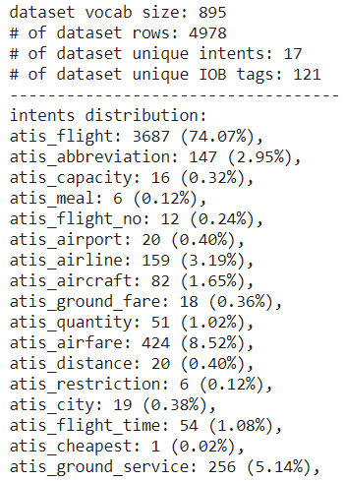
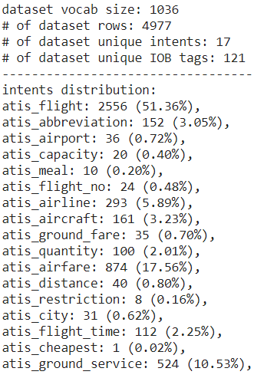
Our Final Training Dataset based on ATIS

Slide 3
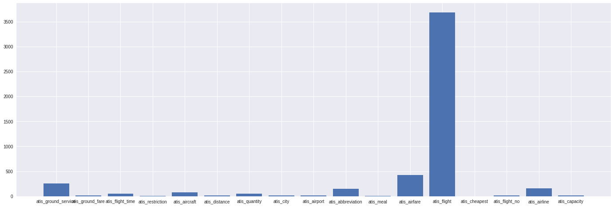
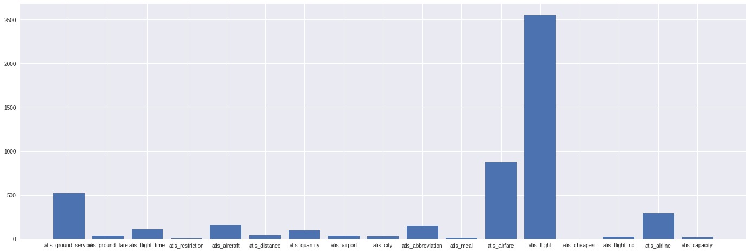
From very imbalanced
To somehow balanced

Slide 4
BERT based model result comparison
Source | Intent Accuracy | Slot Filling F1 Score | Overall Accuracy
The Original Paper* | 97.9 | 96.1 | 88.6
Our result with the imbalanced dataset | 98.78 | 96.16 | 88.5
Our result with the balanced dataset | 99.22 | 96.16 | 89.81
*They took a different approach about samples with multiple intents, so the results are slightly different.

Slide 5
BLTSM based model result comparison (still in progress)
Dataset | Intent Accuracy | Slot Filling F1 Score | Overall Accuracy
The Original Paper | 98.99 | 96.89 | -
Our result with the imbalanced dataset* | 97.87 | 95.53 | -
Our result with the balanced dataset** | 97.87 | 95.23 | -
* A lot of epochs and also some luck is needed to get a similar result to the Original Paper.
** Training is still in progress.

Slide 6
BERT based model outputs on some other examples
<atis_flight> : On [Aug:B-depart_date.month_name] [fifteen:B-depart_date.day_number] I need a flight going from [Shiraz:B-fromloc.city_name] to [Urmia:B-toloc.city_name].
<atis_flight> : I want a flight from [Tabriz:B-fromloc.city_name] to [Bandar:B-toloc.city_name] [Abbas:I-toloc.city_name] for [August:B-depart_date.month_name] [22nd:B-depart_date.day_number] in the [morning:B-depart_time.period_of_day] on [Qeshm:B-airline_name] [air:I-airline_name].
<atis_airfare> : What is the airfare for a [1st:B-class_type] [class:I-class_type] flight from [Tehran:B-fromloc.city_name] to [Rasht:B-toloc.city_name].
<atis_airport> : find me airports in [Mashhad:B-city_name].

Slide 7
Further remarks
Tweaking models for better handling of imbalanced dataset
Further optimizing hyperparameters
Translating ATIS to Persian & using ParsBERT & …
Developing other modules of task-oriented dialogue systems

Slide 8

Thank You!

